Slide 1
IRIS API Creation
Praveen Felix S
July, 2023

Slide 2
Agenda
Introduction
What is IRIS
Pre-Requisites
Workbench Package Installation
IRIS log path
Creation of IRIS API
Postman Execution

Slide 3
Introduction
This document is intended for users who are striving to configure and understand the IRIS architecture. This document is specific to configuration related to TAFJ platform as well if you understand the JMS architecture with T24.

Slide 4
What is IRIS
The Interaction Reporting and Information Services (IRIS) framework is designed to facilitate communication between frontends and back-office banking systems. It is designed to provide information in a consistent format regardless of the back-office that originally stored the information.

Slide 5
Pre-Requisites
Jboss 7.0 GA
Design Studio R18 and above
Basic understanding of Jboss subsystem.
Basic working knowledge on Design Studio.
IRIS Work bench design time and runtime packages

Slide 6
Workbench Package Installation
Deploying the IRIS runtime package “irf-provider-container” and IRIS Design time package “irf-web-client.war” in the jboss deployment folder

Slide 7
Creation of IRIS API
The creation of IRIS API requires multiple steps as below:
1. Installing irf-m2repo.zip maven repository in Design Studio(One time setup)
2. Creation of T24 artefacts(Version/Enquiry)
3. Creation of Container Project
4. Creation of Service Project
5. Create Provider API in Workbench(Design time)
6. Maven install - Building Service project with provider API artefacts
7. Maven build - Running Container Project with dependency as Service Project
8. Deploy the war in Jboss/deployment folder
9. Access api through Postman client
We have screenshots of the steps under each of the subdivision

Slide 8
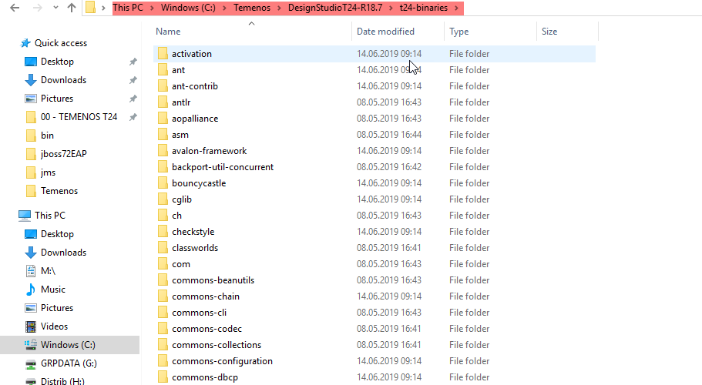
Installing irf maven repository
Normally Temenos provides the offline maven repository for T24 plugins in the name – For Ex : “t24-binaries-R18.7_<xxxx…..>.zip”. Similarly, we will receive an offline maven repository for IRIS workbench package “irf-m2repo.zip”. This need to be extracted in to “t24-binaries” which will be inside Design Studio installation folder which is the default offline maven repository.

Slide 9
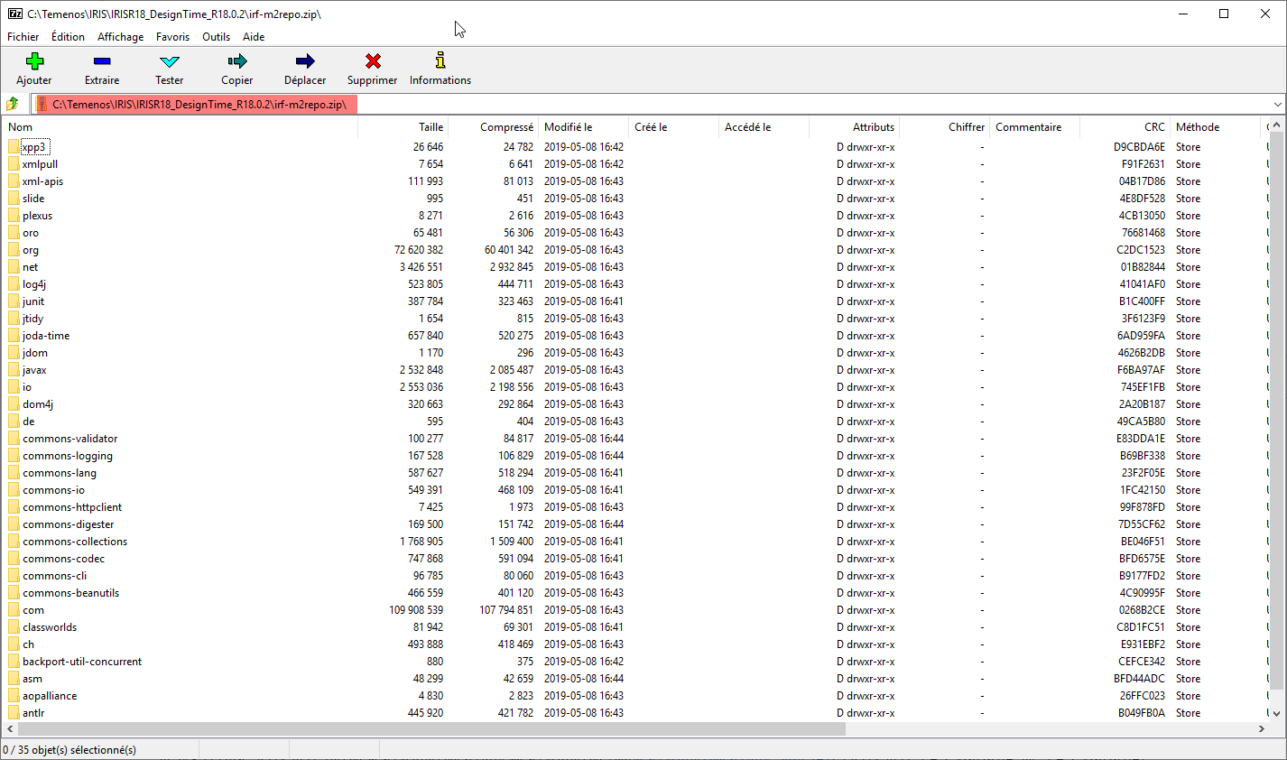
Irf-m2repo package

Slide 10
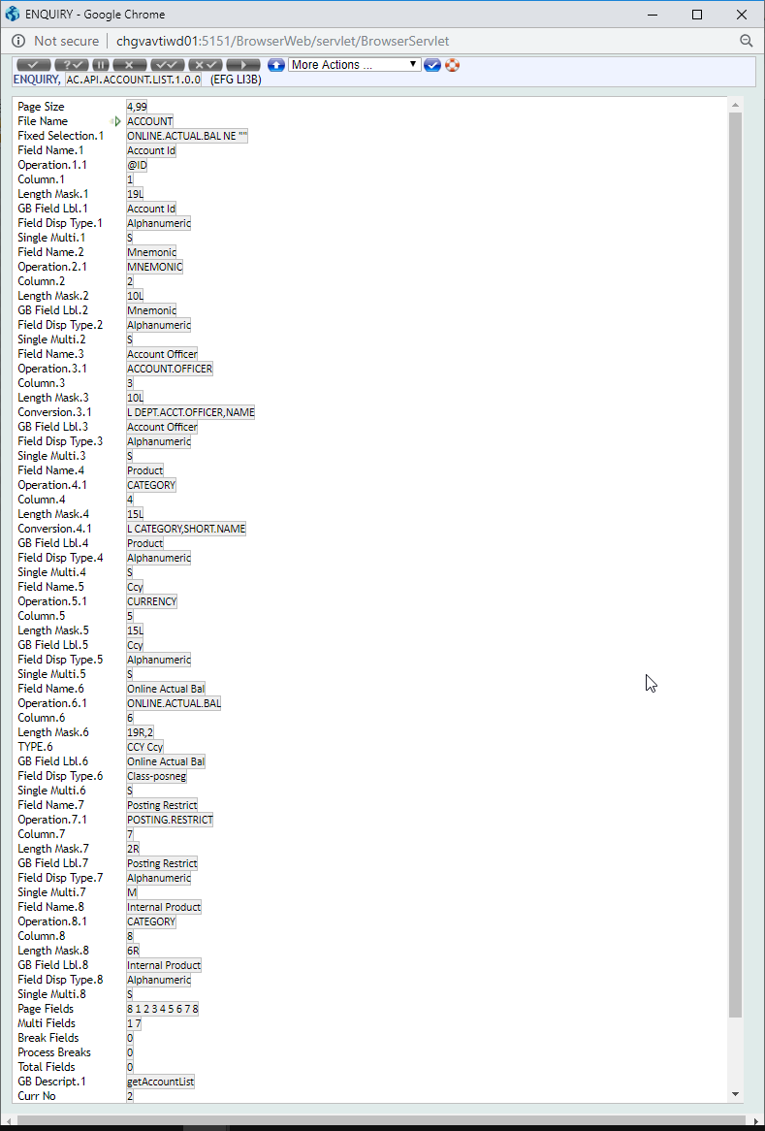
Creation of T24 artefacts
Create a T24 Account enquiry to expose it as IRIS API. The naming convention AC.API.ACCOUNT.1.0.0

Slide 11
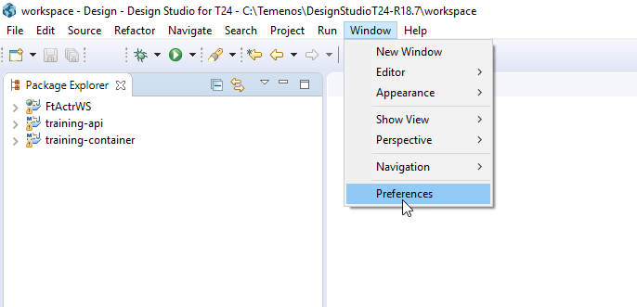
Once the irf maven repository is copied then restart the Design Studio. You need to add the irf related archetypes into maven archetype catalogs. For which if you notice there is a “archetype-catalog.xml” file inside irf-m2repo.zip. which will be used so you can extract anywhere you want.
In Design Studio click Window ->Preferences

Slide 12
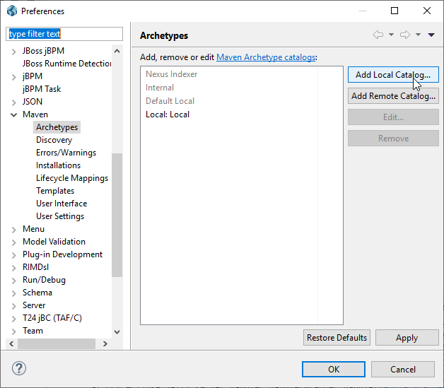
Then under Maven ->Archetypes, you can click on Add Local Catalog button

Slide 13
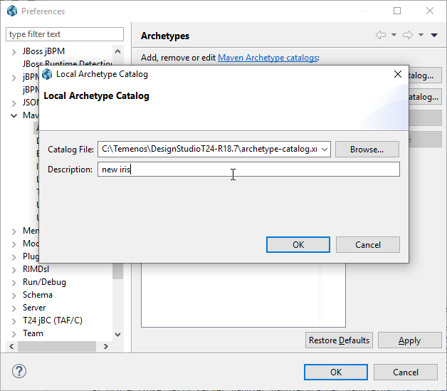
You can browse and choose the archetype-catalog.xml extracted as previously mentioned.
Click ‘Ok’

Slide 14
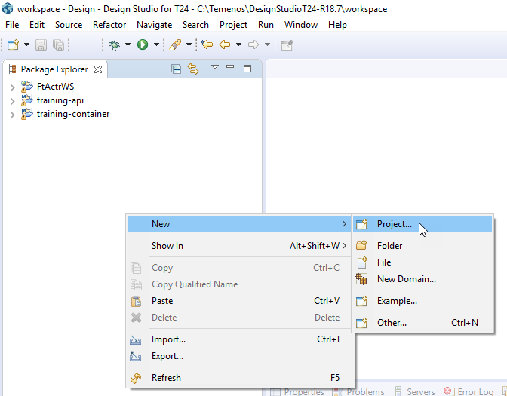
Creation of Service Container
Create a new Maven project as below

Slide 15
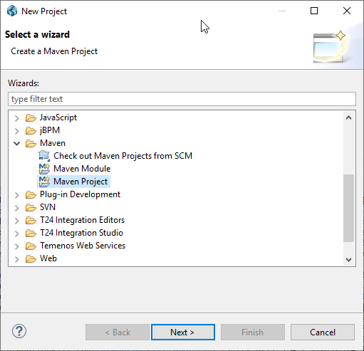
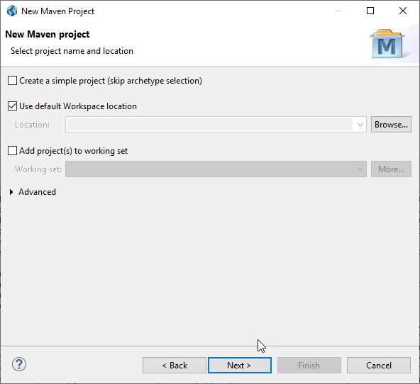

Slide 16
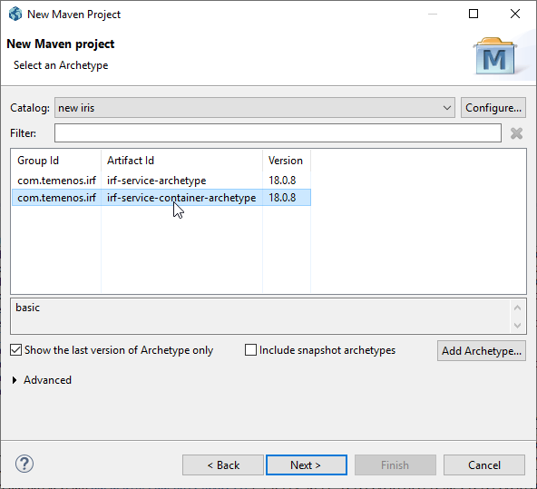
Choose “irf-service-container-archetype” and Next

Slide 17
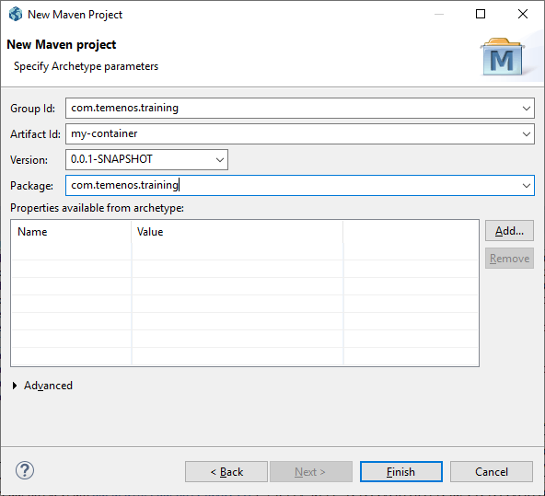
Specify Group Id, Artifact Id, Package as shown and click Finish

Slide 18
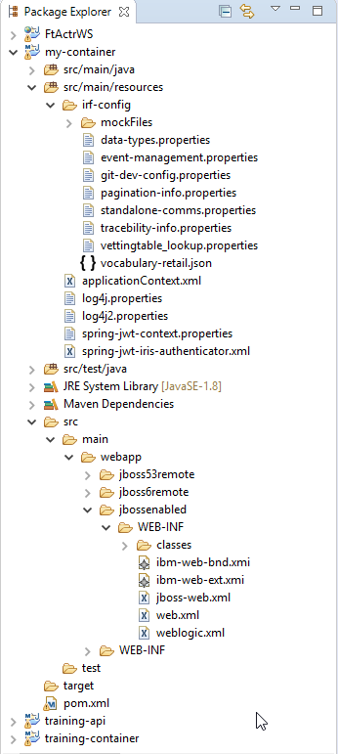
Once the project is created, we can see the folder structure as below.

Slide 19
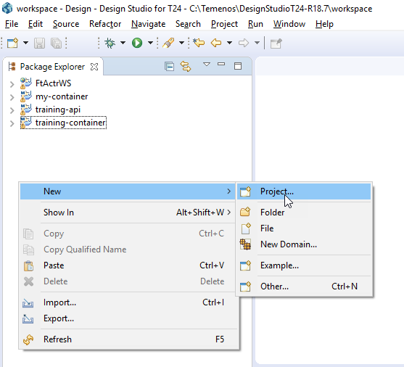
Creation of Service Project
Create a new Maven project as below

Slide 20
Next

Slide 21
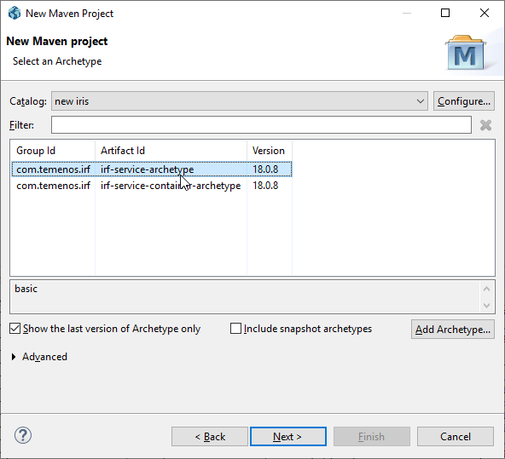
Choose “irf-service-archetype” and Next

Slide 22
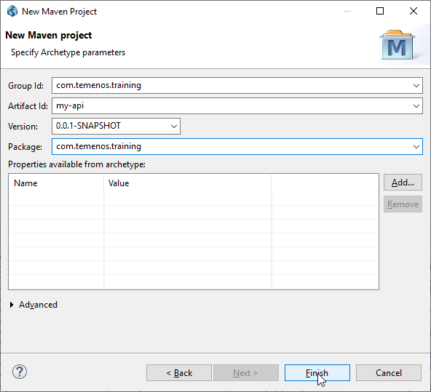
Specify Group Id, Artifact Id, Package as shown and click Finish

Slide 23
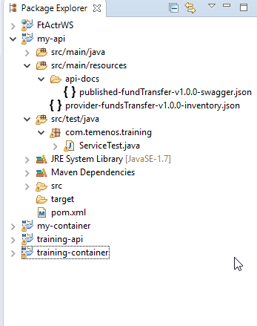
Once the project is created, we can see the folder structure as below

Slide 24
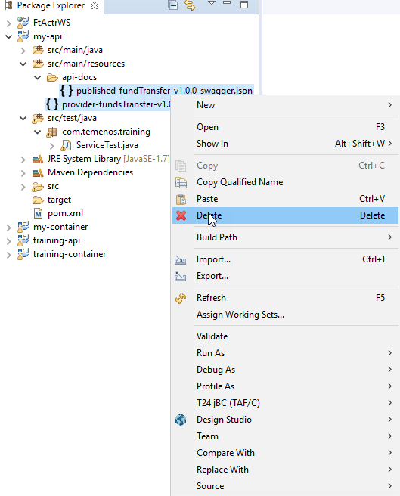
Delete all the default swagger files inside src/main/resources/api-docs

Slide 25
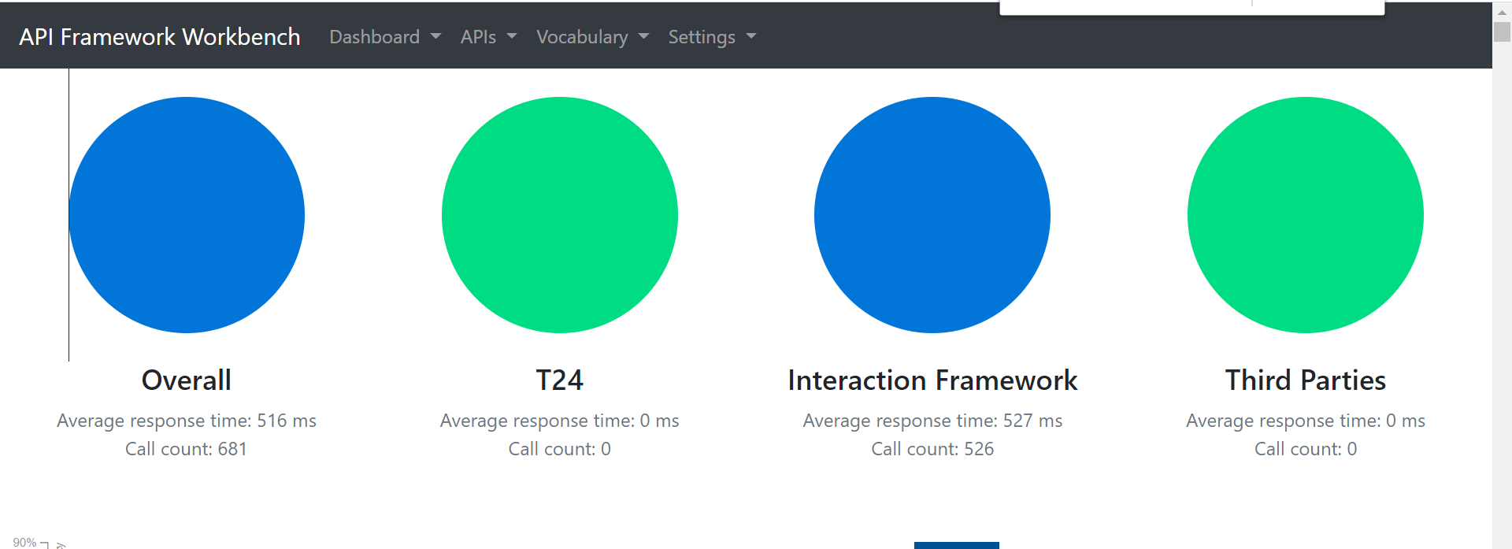
Creation of provider API artefacts
You can access the IRIS workbench with http link. For ex:
http://<IP>:<port>/irf-web-client

Slide 26
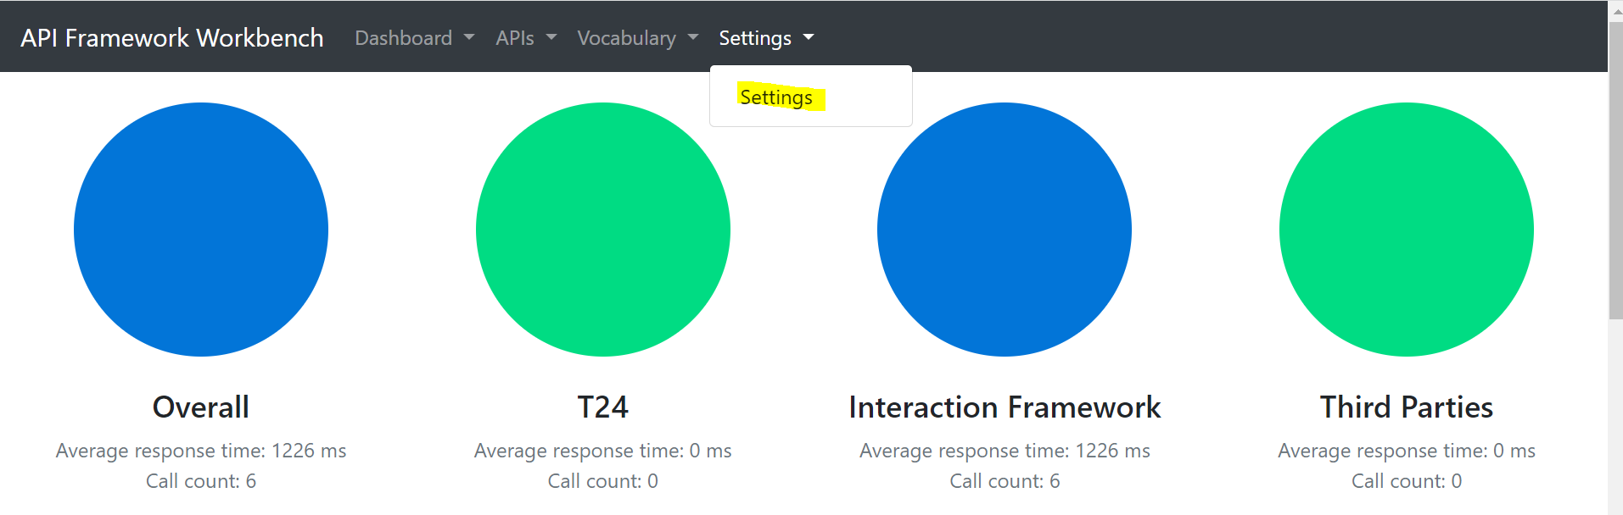
Click on Settings
You can find a page loaded as above, now you need to specify where the runtime-time packages(irf-provider-container) are deployed by specifying the url. For that you can either add a server or amend the existing server.

Slide 27
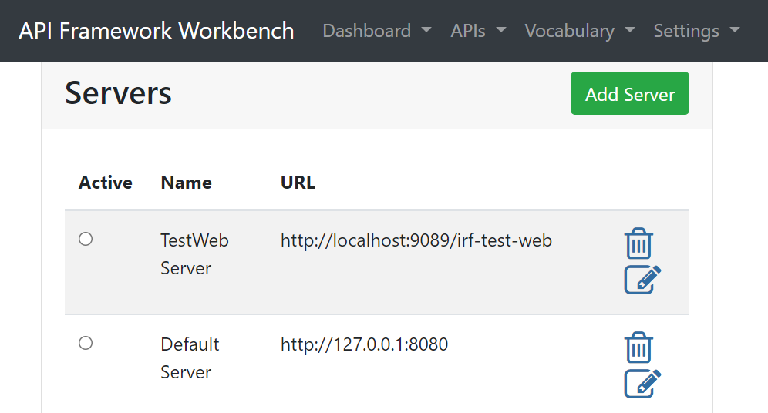

Slide 28
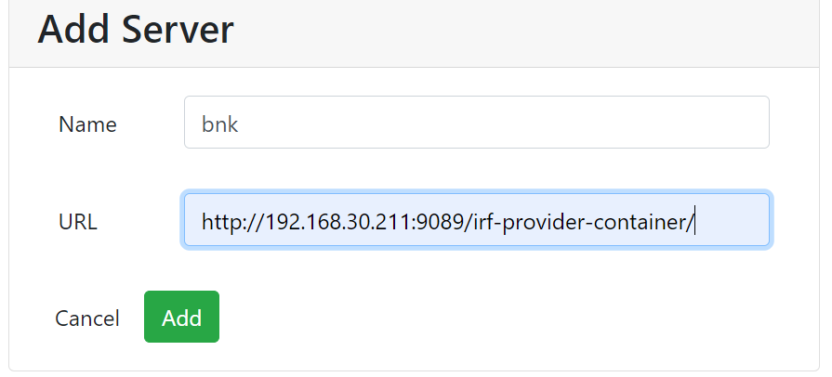
Click on Add Server and provided the design time url
Then click Add

Slide 29
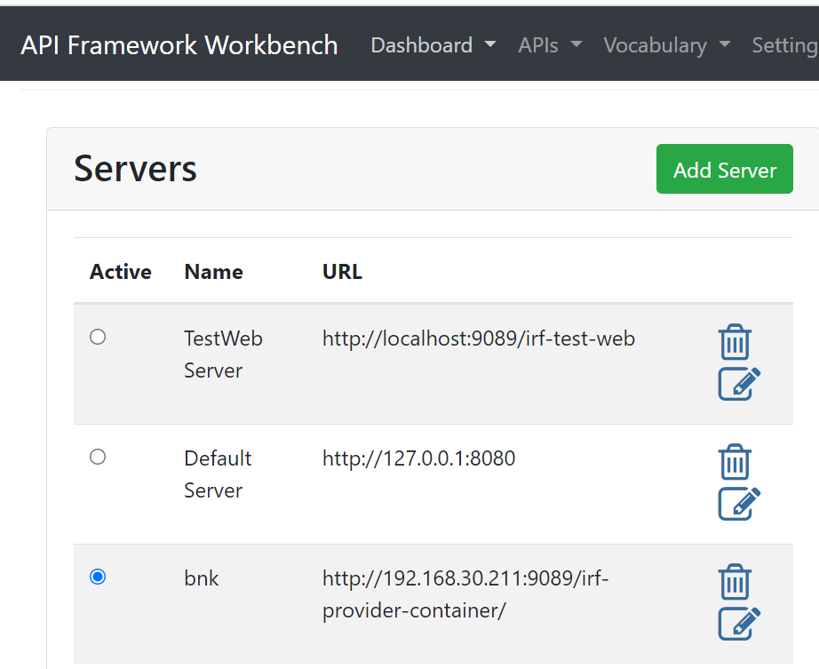
Choose the server to connect

Slide 30
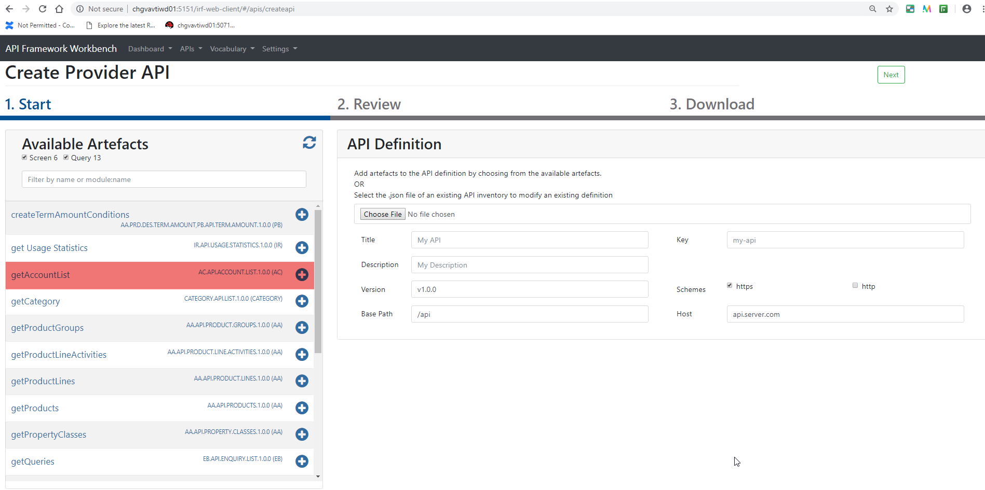
Click on “Create Provider API” and choose the Artefacts to expose it to an API

Slide 31
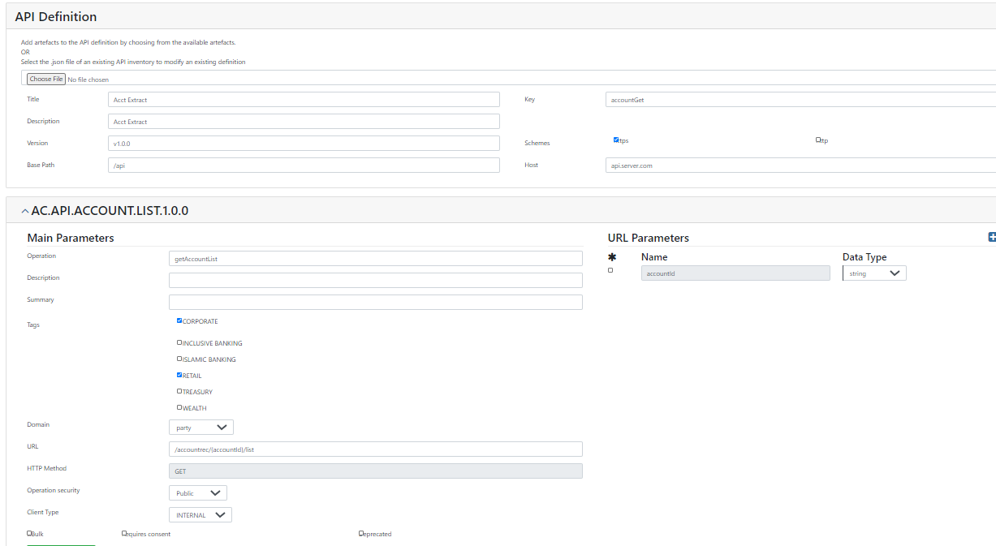
Fill the necessary fields and click Next

Slide 32
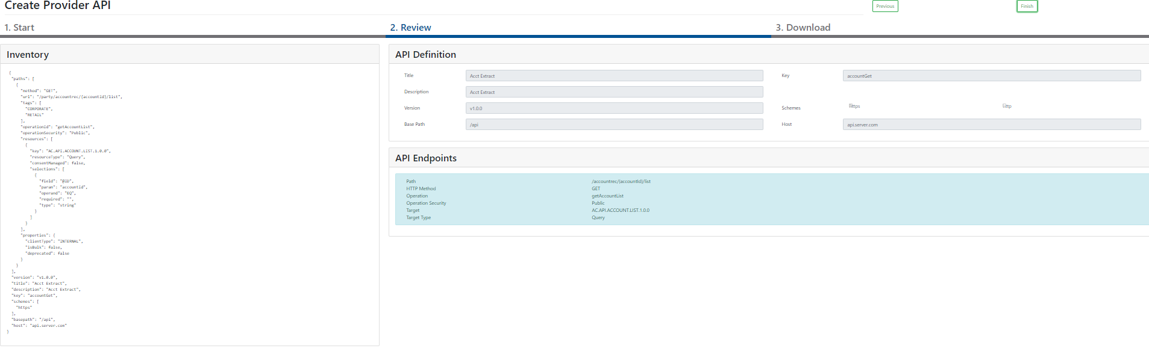
Verify all the fields and click Finish

Slide 33
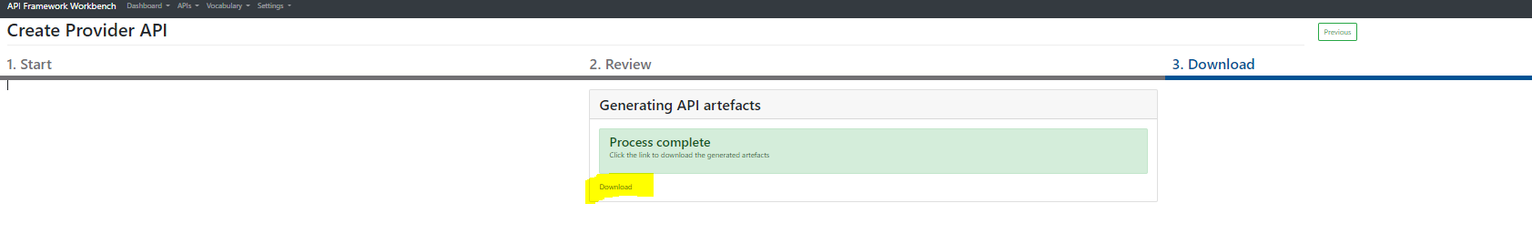
Then click Download

Slide 34
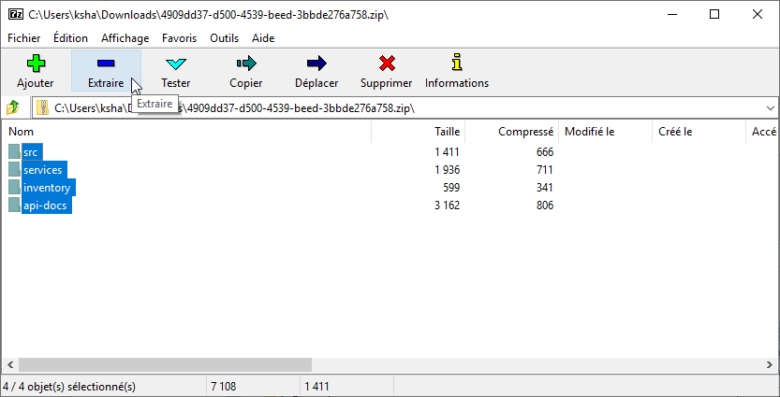

Slide 35
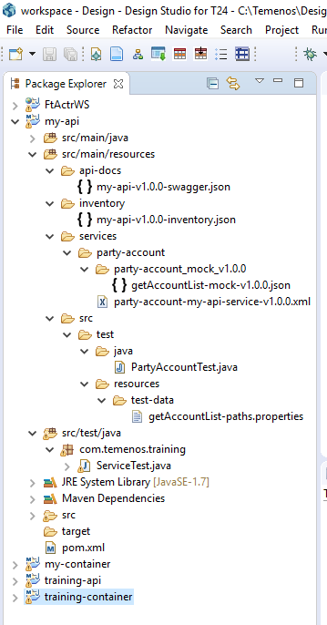
Maven install - Building Service project with provider API artefacts
Extract the contents of the zip downloaded from previous steps in to “my-api” service project under src/main/resources folder.
Once the contents are extracted in the service project the folder structure should look as below

Slide 36
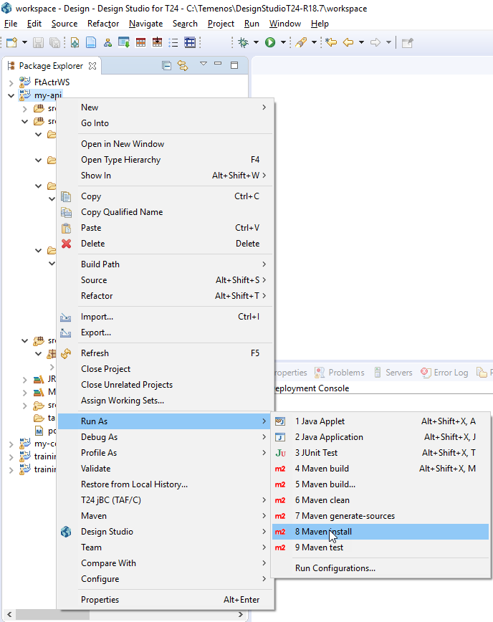
Execute maven install

Slide 37
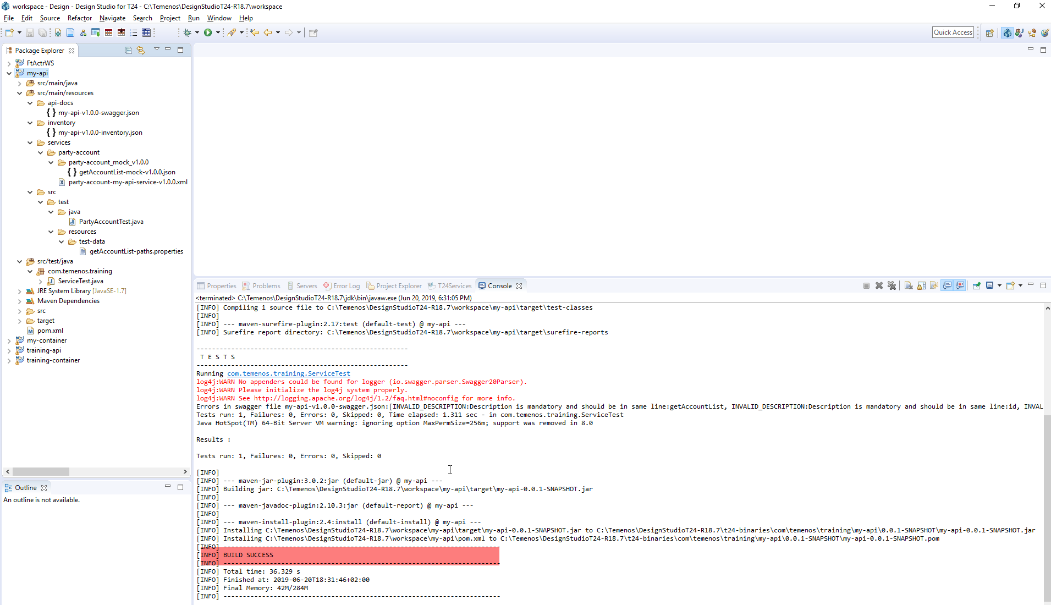
Once you do a maven install, it should have a “BUILD SUCCESS” message in the Console

Slide 38
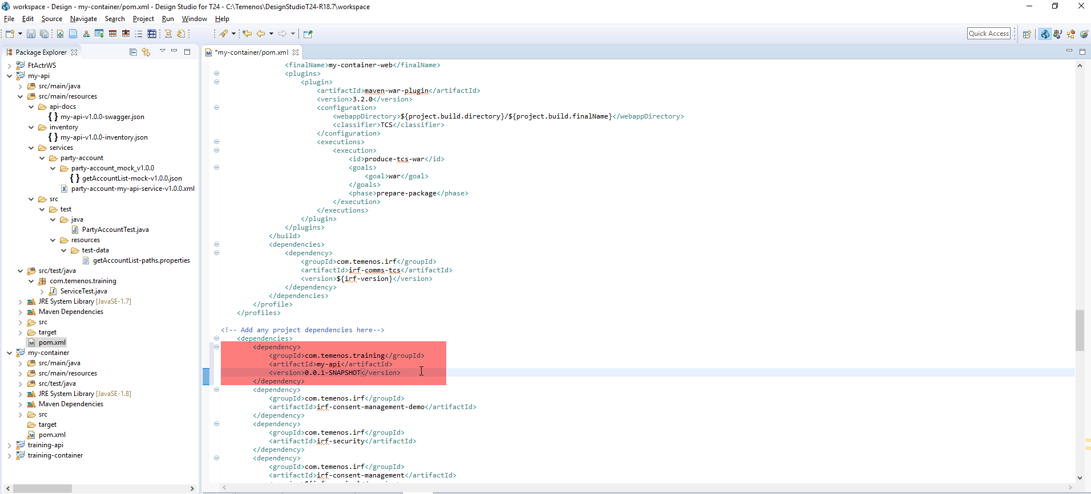
Maven build - Running Service Container with dependency as Service Project
To run the Service Container project with dependency as my Service Project created.
You need to edit the pom.xml of my-container project and add the dependency as shown below

Slide 39
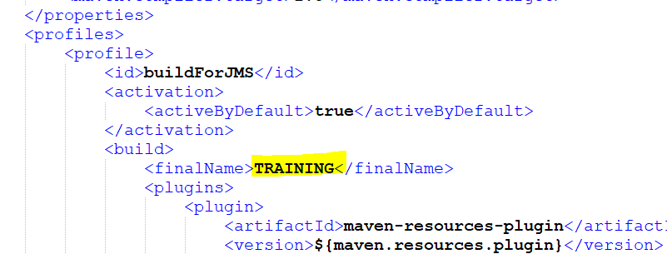
Set “buildForJms” as “true” and also provide the Iris war file name in which it needs to be generated.

Slide 40
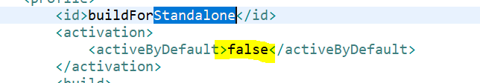
Set “buildForStandalone” as “false”

Slide 41
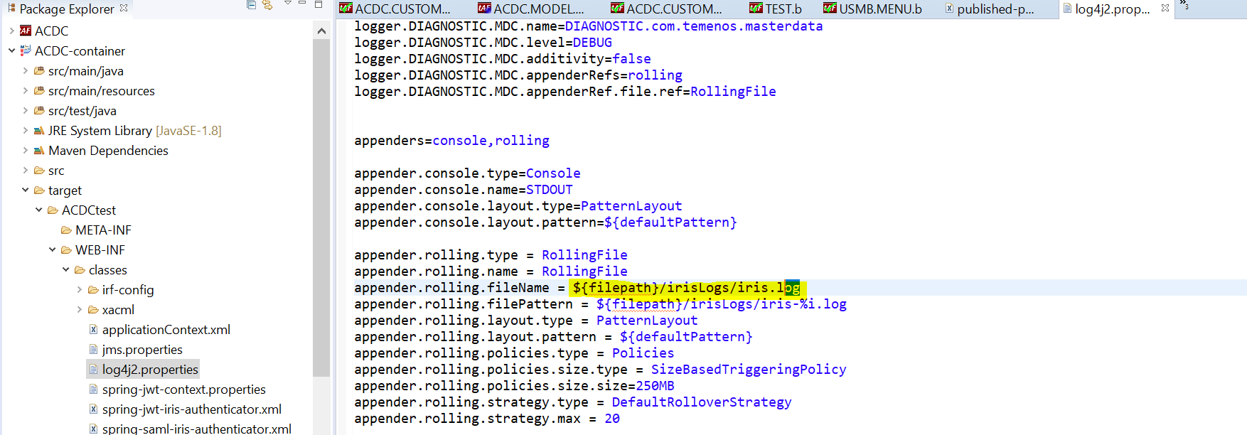
Providing IRIS log Path

Slide 42
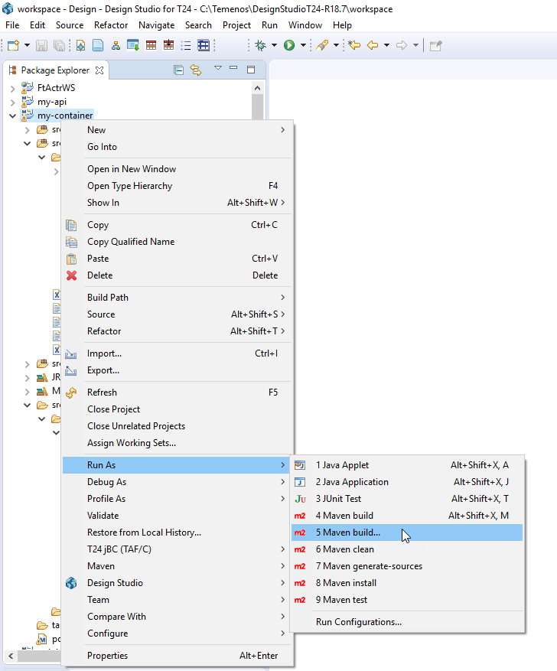
Execute maven build

Slide 43
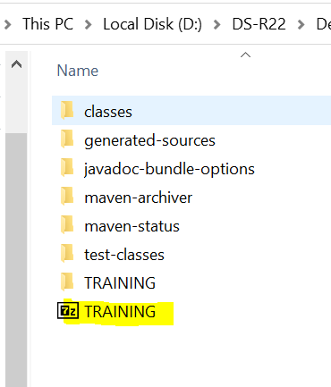
After Maven build is completed for container project the war file will be generated under container/target folder
Then Deploy the war into the jboss/deployment folder and check war file is deployed successfully

Slide 44
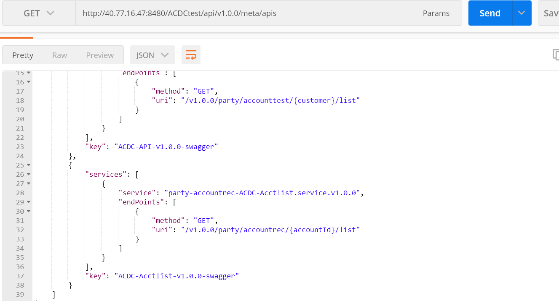
Postman Execution
Normally you will use the hostname and port number where generated war is deployed.
http://<IP>:<PORT>/TRAINING/api/v1.0.0/meta/apis

Slide 45
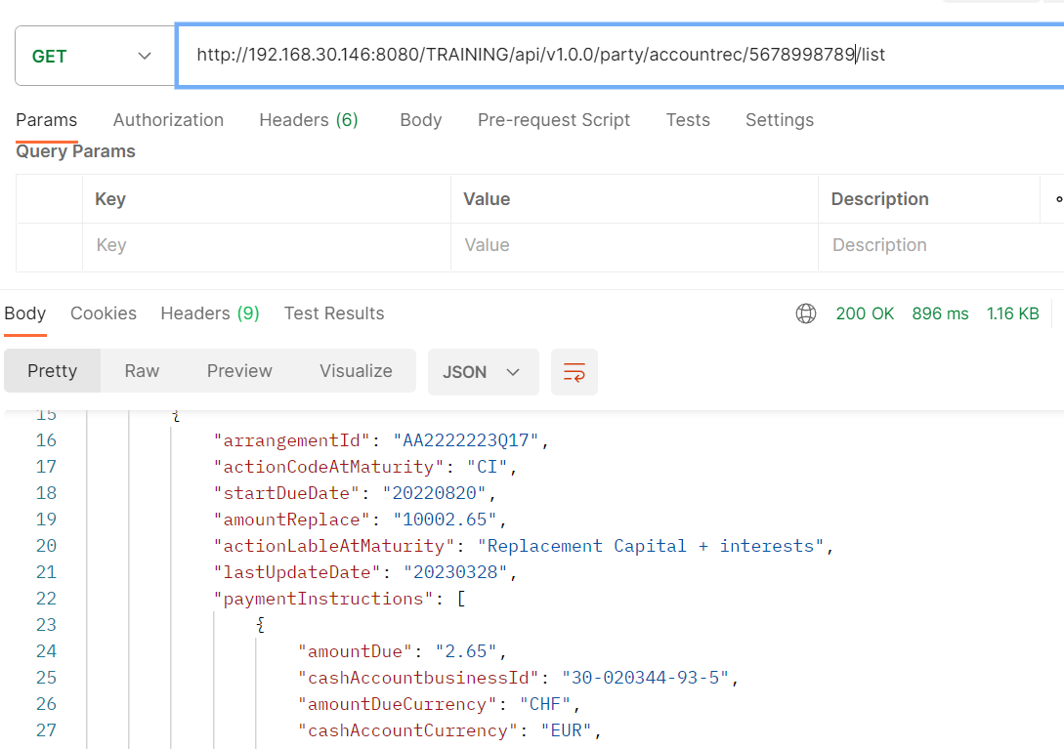
http://<IP>:<PORT>/TRAINING/api/v1.0.0/party/accountrec/{accountId}/list

Slide 46
Temenos Docs link for IRIS Framework
https://docs.temenos.com/docs/Solutions/Technology/Interaction_Framework/IRISR18/IRIS/IRISR18/iris-main.htm

